Slide 1
Positively Impacting our Communities- Collaboration with Patients, Practitioners, Educators and Researchers: Health Equity Considerations, Community Linkages & the Pathways Community HUB Model
Capital Area Health Alliance
December 12, 2012
Renée Branch Canady, PhD, MPA
Health Officer, Ingham County Health Dept.

Slide 2
Where do we begin?
Social Determinants of Health
The economic and social conditions that influence the health of individuals, communities, and jurisdictions as a whole.
They include, but are not limited to:
Safe
Affordable
Housing
Quality
Education
Job
Security
Social
Connection
& Safety
Living
Wage
Access to
Transporta-
tion
Availability
of Food
Dennis Raphael, Social Determinants of Health; Toronto: Scholars Press, 2004
Notes:
Renee presents this + next slide: Establish that there are different levels of “upstream”—you can move to the Social Determinants level, but the root causes are the explicit forms of oppression that our workshops address.

Slide 3
Root Causes
Institutional
Racism
Class Oppression
Gender
Discrimination
and Exploitation
LABOR
MARKETS
TAX
POLICY
Power and Wealth Imbalance
GLOBALIZATION
&
DEREGULATION
HOUSING
POLICY
EDUCATION
SYSTEMS
SOCIAL
SAFETY
NET
SOCIAL
NETWORKS
Safe
Affordable
Housing
Job
Security
Social Determinants of Health
Transportation
Living
Wage
Quality
Education
Availability
of Food
Social
Connection
& Safety
Psychosocial Stress / Unhealthy Behaviors
Disparity in the Distribution of Disease, Illness, and Wellbeing
Adapted from R. Hofrichter, Tackling Health Inequities Through Public Health Practice.

Slide 4
The discourse is changing…
Health Disparity
Health Inequity
“A disproportionate difference in health between groups of people.”
By itself, disparity does not address the chain of events that produces it.
“Differences in population health status and mortality rates that are systemic, patterned, unfair, unjust, and actionable, as opposed to random or caused by those who become ill.” Margaret Whitehead

Slide 5
Community Care System Evolution in MI
Critical Path
Community Integrated
Health Care System 3.0
Coordinated Seamless
Community Care System 2.0
Community
Integrated
Healthcare
Uncoordinated Community Care System 1.0
Organized, Accountable, Person-Centered Community Services
Confused Consumers; Inefficient Care Delivery
Patient, Population, and Community-Centered
Community Health Resource Linked
Cost, Quality, and Population Health Outcome Transparency
Community Healthy Living Choices
Community Health Integrated networks capable of addressing psychosocial, economic and LTC needs
Right care, at right time, in right setting
Population-based reimbursement
Learning Organization: Capable of rapid
deployment of Best Practices
Community Health Integrated
Community Healthy Living Oriented
Community Health Capacity Builder
Community based support developer
Shared community health responsibility
E-health and tele-health capable
Wide use of remote monitoring and tele-health and e-health management
Health E-Learning resources, social networking, health literacy tools
Community service agencies ** in formal network
Referral of high risk clients to approp System
Coordinated care for moderate to low risk clients via screening, referral to appropriate agency or service or assignment to CHW
IT HUB and interconnectivity with all service agencies
Efficient, accountable care
Transparent Cost / Quality Performance
Results-oriented
Assured access to care
Improved consumer experience
Public reporting
** Agencies with services related to social & other determinants of health
Community agencies in own silos
Each with care managers
Each producing care plans
Each producing individual / family records
Fragmented care for individuals / families with multiple needs
Uncoordinated cross-agency care for individuals, families
Little or no cross-agency communication or data sharing
Little or no agency communication with medical care providers
Inefficient, redundant (e.g. costly) services
No transparent quality or cost performance data

Slide 6
Michigan Pathways to Better Health (MPBH) Demonstration Project
Pathways Community HUB Model
Uses Community Health Workers (CHWs) to coordinate use of social, emotional, economic, and educational resources
CHWs use Pathways constructed to harness existing community resources in the pursuit of common outcomes
Coordinate efficient service delivery through a centralized Community HUB
Performance based on outcomes that are measured; and quality and performance is reported to the community
Pathways Community HUB Model http://www.innovations.ahrq.gov/guide/HUBManualTOC.aspx
Notes:
CHWs are lay health workers recruited from the neighborhood in which they will serve; trained to build relationships with and provide I & R to target pop; assist them in navigating the social, emotional, economic, and educational resources that mitigate barriers to attending to their health needs.
Pathways outcome-based framework for guiding and monitoring CHW activities
HUB centralized coordination of activities; database of community performance linking social and health metrics for enhancing sustainability

Slide 7
Pathways
Social Service Referral
Smoking Cessation
Medication Assessment
Medication Management
Medical Referral
Medical Home
Health Insurance
Health
Social
Notes:
CHWs will receive training on these Pathways, as well as the IT system, chronic disease overviews, relationship building, behavior change, behavioral health/substance abuse,
Long Term Outcomes: the Triple Aim
Reduce total cost of care
Healthcare utilization
Improve healthcare quality
Improve health status

Slide 8
Identify/enroll at risk
Care Coordination
Evidence based Intervention
Final Outcome
Notes:
8

Slide 9
Pathway Model: A Tool to Measure Outcomes
Target Population - Find those at greatest risk
1- Find
Confirm connection to evidence-based care
2 - Treat
Measure the results
3 - Measure
Notes:
Identify those at greatest risk of poor health outcomes and therefore costly healthcare service utiliszation (ER hospital)
Assess health/social concerns, assist in navigation of services, and confirm connection to proper resources
Monitor and record results
Shifts the focus to outcomes
Recognizes the importance of social concerns in relation to health status locally

Slide 10
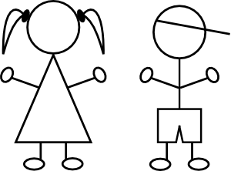
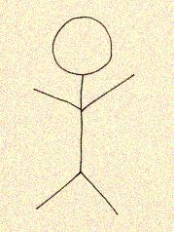
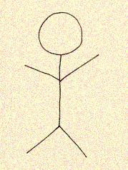
Need to identify the most “at risk”.
Risk determination can be based upon:
Geography = Hot-spotting, poverty data, birth data or other outcome data by census tract / census block
Risk Scoring = Multiple strategies, current and future risk, specific to age and condition
Combination of both?
ROLE OF TRUST??
Building “Community”
Notes:
Data-driven tartgeting those at-risk using utilization data, claims data, or clinicians monitoring their registry

Slide 11
“Doing our Own Work” 4 Levels of Oppression and Change
Personal
Feelings, beliefs, values
Interpersonal
Actions, behaviors, language
Institutional
Rules, policies, procedures
Cultural
Collective ideas about what is normal, true, right, beautiful
Adapted from Dr. Valerie Batts, “Is Reconciliation Possible? Lessons from Combating Modern Racism”
Notes:
Renee presents

Slide 12
Care Coordination Agency
(CHWs)
Regional organization and tracking of care coordination
Focus on at-risk
Eliminate duplication
Benchmarks – confirmed
connection to care
Food
Housing
Healthcare
HUB
Jobs
Care Coordination Agency
(CHWs)
Care Coordination Agency
(CHWs)
Food
Housing
Food
Housing
Healthcare
Healthcare
Jobs
Jobs
Community HUB System
Collaborative Effort

Slide 13
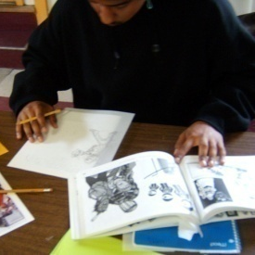
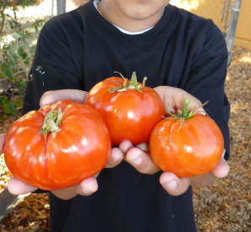
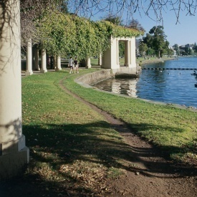
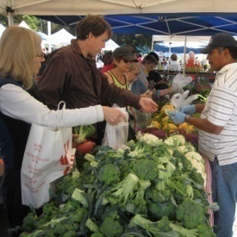
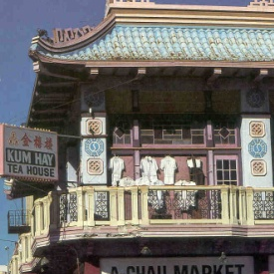
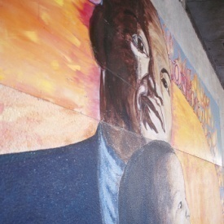
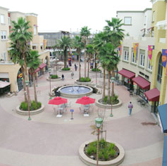
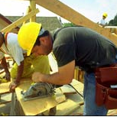
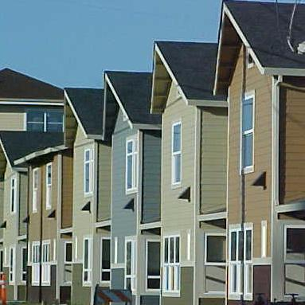
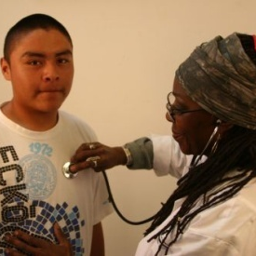
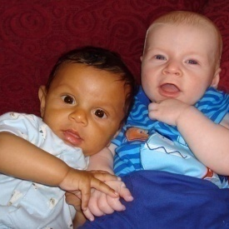
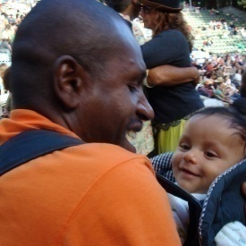
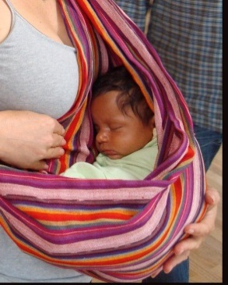
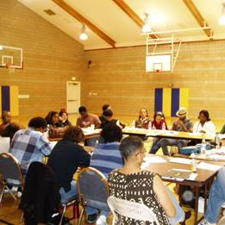
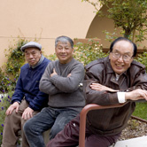
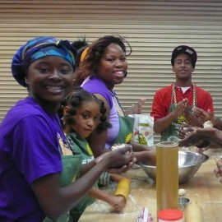
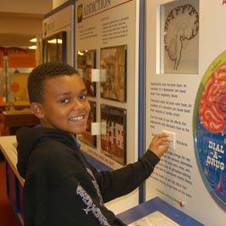
Housing
Childcare
Medical Care
Jobs
Healthy Food
We each have a role
Clean Air
Parks and Activities
Policy Makers
Education
Economic Justice
Preschool
Safe Neighbor-hoods
Residents
Transportation

